Slide 1
CSCI 4/5588 Machine Learning-II Neural Network Chapter #4
Md Tamjidul Hoque

Slide 2
Central Idea of NN
Here for Artificial Neural Network (ANN), we will extend our previous models for classification problem.
The central idea is to extract linear combinations of the inputs as derived features, and then model the target as a nonlinear function of these features. The result is a powerful learning method, with widespread applications in many fields.
We can use parametric forms of the basis functions and the parameter values are adapted during training.
The most successful model of this type on the context of pattern recognition is the feed-forward neural network.
The formulation of the ANN was inspired by the idea of mimicking the brain.

Slide 3
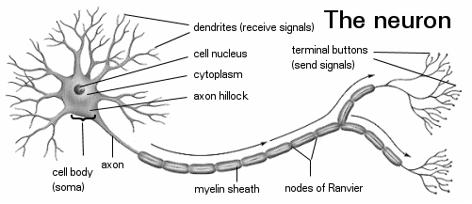
The Brain Unit: Neuron
Dendrites receive signals
Cell body, accumulating signals can spike to transmit electric nerve impulses if the accumulation is above some threshold value.
Axon transmits the signal to the terminals (synapse). Axon is like a plastic-coated electrical wire.

Slide 4
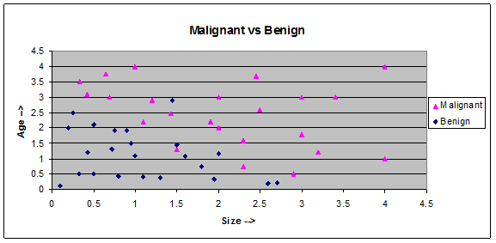
Given: Cancer Dataset

Slide 5
Brain, the Neural Network
We can think of the brain as a massive neural network.
We can think of ANN as a brain:
Where we adjust the weights (β) of the combination of the logistic regression by training. Analogy: We exercise to train our brains.

Slide 6
Train the NN: Brain or ANN
Regarding training your Brain or ANN here are some exciting examples:
Train to see like a bat.
Train your other part of the brain to see.
Brain Interface (see the Nature paper for detail)
Train ANN to drive or fly, or ….
NN could be formed to perform extremely powerfully task for a particular purpose. Example: Brain-Man.
Motivations:
NN can be a very powerful tools
Can be used for developing exciting applications
Can be used to build complex problem solver without hand-coding the criteria and for building most of it.

Slide 7

Modeling Neuron
Neuron
Modeling single neuron as logistic unit

Slide 8
Hidden Layer, When?
Let us first develop the intuition by developing the logic functions?
NOT

Slide 9
Hidden Layer, When? …
OR
Answer
Linearly separable?

Slide 10
Hidden Layer, When? …
AND
Answer
Linearly separable?

Slide 11
Hidden Layer, When? …
XOR
Linearly separable?
We can extend the truth-table to use the linearly separable logic functions, right?

Slide 12
Hidden Layer, When? …
XOR
Answer: ‘Hidden layer’, when the output classes are NOT linearly separable.

Slide 13
Notation for NN
Term (T):
σ = activation function,
Z = output of the activation function
When sigmoid is the activation fn..

Slide 14
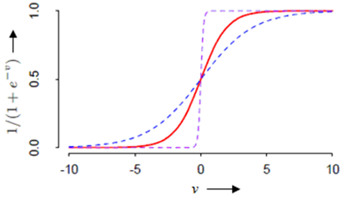
Activation Function
Plot of the sigmoid function σ(v) = 1/(1+exp(−v)) (red curve), commonly used in the hidden layer of a neural network.
σ(sv) for s = 1/2 (blue curve)
σ(sv) for s = 10 (purple curve)

Slide 15
Fitting Neural Network
Here, we seek values for parameters (i.e., β) of neural network model that make the model fit the training data well.
For regression, we use sum-of-squared errors as our measure of fit (error function)
More generally we will be using Error (E) as:
The generic approach to minimizing E(β) is by gradient descent, called back-propagation in this setting.
Because of the compositional form of the model, the gradient can be easily derived using the chain rule for differentiation.
This can be computed by a forward and backward sweep over the network, keeping track only of quantities local to each unit.

Slide 16
Notation for NN
Term (T):
σ = activation function,
Z = output of the activation function
When sigmoid is the activation fn..

Slide 17
Figure for Coding Purpose

Slide 18
Formulating Back-Propagation …

Slide 19
Formulating Back-Propagation …
The back-propagation learning rule is based on gradient descent.
Here, we want to minimize the error by changing the weights.
The weights are initialized with random values, and then they are changed in a direction that will reduce the error:
The overall idea of the error back-propagation will be
- to compute the discrepancy of the targeted output versus the predicted output from output node(s) first and
- then to propagate backward to compute the discrepancy for each of the nodes in the hidden layer except the input layer.
Question: So, why not input layer?
Ans: Because we do not want to change the input layer.

Slide 20
Formulating Back-Propagation …
First we will compute the rate of changes of error with respect to the weight connected to the output node(s):

Slide 21
Formulating Back-Propagation …

Slide 22
Formulating Back-Propagation …

Slide 23
Formulating Back-Propagation …
Let us next compute the rate of changes of error with respect to the weight for the hidden layer(s) similarly.

Slide 24
Formulating Back-Propagation …

Slide 25
Formulating Back-Propagation …

Slide 26
Formulating Back-Propagation …

Slide 27
Formulating Back-Propagation …

Slide 28
Figure for Coding Purpose
Review

Slide 29
Formulating Back-Propagation …
Bias term:
If we revisit the network Figure, we see the bias terms supply +1 to the node(s) of the next layer always.
If we use Equation (iii) for the bias term at layer (L-1), we can rewrite equation (iii) as:
Now, we have generated required equations to describe the back-propagation algorithm.

Slide 30
Recall: Forward Propagation Equations

Slide 31
Algorithm 1: Error Back-propagation
From a data point (x_{i}, y_{i}), apply an input vector x_{i} to the network and forward propagate through the network (as we computed the logistic regression) as we described in (11.5).
For each of the output node / unit compute the error term
For each of the hidden layer node /unit compute the error term

Slide 32
Error Back-propagation
This two-pass procedure is known as back-propagation. It has also been called the delta rule.
The advantages of back-propagation are: simple, local in nature.
In the back propagation algorithm, each hidden unit passes and receives information only to and from units that share a connection.
Hence it can be implemented efficiently on a parallel architecture computer.
Processing each observation one at a time, updating the gradient after each training case, and cycling through the training cases many times as it is in (11.13): ,
It can also be a batch learning: ,
A training epoch refers to one sweep through the entire training set.

Slide 33
Error Back-propagation
The learning rate α for batch learning is usually taken to be a constant, and can also be optimized by a line search that minimizes the error function at each update.
With online learning α should decrease to zero as the iteration r → ∞.
(Online => online training implies that a learning step is taken place at each presentation of a randomly drawn training pattern. Online training is especially useful when the training patterns are drawn from a time-dependent environmental distribution).

Slide 34
Program Code
% ////////// initialization
L=[2 4 4 1]; % // Defining the layers: Total of 4 layers, # of nodes are 2, 4, 4, 1 respectively from input to output layer
alpha = 0.2; % //usually alpha < 0, ranging from 0.1 to 1
target_mse=0.05 % // one of the exit condition
Max_Epoch=2000 % // one of the exit condition
Min_Error=Inf
Min_Error_Epoch=-1
epoch=0; % // 1 epoch => One forward and backward sweep of the net for each training sample
mse =Inf; % // initializing the Mean Squared Error with a very large value.

Slide 35
Program Code
% ////////// load datasets
load X.txt % // contains features: Column1: x1 (size) and Column2: x2 (age)
[Nx,P]=size(X); % // Nx = # of sample in X, P= # of feature in X
load Y.txt % // Target Output
[Ny,K]=size(Y); % // Ny = # of target output in Y, K= # of class for K classes when K>=3 otherwise, K=1 (for Binary case)

Slide 36
Program Code
% // You may optionally check the dimensions etc
% Optional: Since input and output are kept in different files, it is better to verify the loaded sample size/dimensions.
if Nx ~= Ny
error ('The input/output sample sizes do not match');
end
% Optional
if L(1) ~= P
error ('The number of input nodes must be equal to the size of the features')
end
% Optional
if L(end) ~= K
error ('The number of output node should be equal to K')
end

Slide 37
Program Code …
% Allocate the matrix to present and operate the ANN
% forming the number of Beta/weight matrix needed in between the layers
B=cell(length(L)-1,1);
for i=1:length(L)-1 % Assign uniform random values in [-0.7, 0.7]
B{i} =[1.4.*rand(L(i)+1,L(i+1))-0.7];
end
%Let us allocate places for Term, T
T=cell(length(L),1);
for i=1:length(L)
T{i} =ones (L(i),1);
end
Example:
rand (3,2) =
0.66721 0.56750
0.51195 0.17222
0.19843 0.20340

Slide 38
Program Code …
%Let us allocate places for activation, i.e., Z
Z=cell(length(L),1);
for i=1:length(L)-1
Z{i} =zeros (L(i)+1,1); % it does not matter how do we initialize (with '0' or '1', or whatever,) this is fine!
end
Z{end} =zeros (L(end),1); % at the final layer there is no Bias unit
%Let us allocate places for error term delta, d
d=cell(length(L),1);
for i=1:length(L)
d{i} =zeros (L(i),1);
end

Slide 39
Program Code …
Main part of the program
while (mse > target_mse) && (epoch < Max_Epoch) % outer loop with exit conditions
CSqErr=0;
for j=1:Nx % // for loop #1
Z{1} = [X(j,:) 1]'; % // Load Inputs with bias=1
Yk = Y(j,:)'; % // Load Corresponding Desired or Target output
% forward propagation
… … … … … … … …
CSqErr= CSqErr+sum((Yk-Z{end}).^2);
% back propagation
Compute error term delta backward
… … … … … … … …
Update the weight / parameter (B) of the network
… … … … … … … …
end % for loop #1
end % while end

Slide 40
Program Code
% forward propagation
for i=1:length(L)-1
T{i+1} = B{i}' * Z{i};
if (i+1)<length(L)
Z{i+1}=[(1./(1+exp(-T{i+1}))) ;1];
else
Z{i+1}=(1./(1+exp(-T{i+1})));
end
end % // end of forward propagation
CSqErr= CSqErr+sum((Yk-Z{end}).^2); % // collect sample wise Cumulative Sq Err

Slide 41
Program Code …
% // delta error term for the output layer
d{end}=(Z{end}-Yk).*Z{end}.*(1-Z{end}); // For batch processing you need to take extra care
% //compute the error term for all the hidden layer (and skip the input layer).
for i=length(L)-1:-1:2
d{i}=Z{i}(1:end-1).*(1-Z{i}(1:end-1)).*sum((d{i+1}'.*B{i}(1:end-1,:)),2);
% //sum(A,2) => row wise sum
end
% Now we will update the parameters / weights
for i=1:length(L)-1
B{i}(1:end-1,:)=B{i}(1:end-1,:)-alpha.*(Z{i}(1:end-1)*d{i+1}');
B{i}(end,:)=B{i}(end,:)-alpha.*d{i+1}';
end
end % loop ends for N sample

Slide 42
Program Code …
CSqErr= (CSqErr) /(Nx); % //Average error of N sample after an epoch
mse=CSqErr
epoch = epoch+1
if mse < Min_Error
Min_Error=mse;
Min_Error_Epoch=epoch;
end
end % //while_end
%//////////////////// Transition from Training to Testing ///////////////
Now you should save:
Save: L = [2 4 4 1] or, whatever structure you used for ANN
Save: the best B found % this will be used for prediction or test

Slide 43
Program Code …
% /////// Test section
Here we basically load B’s saved values for the network
and run forward propagation for the query data:
X=[0.5 0.3; 5 4] % test these two-points
for j=1:2
Z{1} = [X(j,:) 1]';
% // forward propagation
for i=1:length(L)-1
T{i+1} = B{i}' * Z{i};
if (i+1)<length(L)
Z{i+1}=[(1./(1+exp(-T{i+1}))) ;1];
else
Z{i+1}=(1./(1+exp(-T{i+1})));
end
end % //end of forward propagation
Z{end} % print the result
end

Slide 44
Program Code … (graph)
% Initialize
Err=[];
Epo=[];
…..
mse=CSqErr
epoch = epoch+1
Err = [Err mse];
Epo = [Epo epoch];
plot (Epo,Err) % plot based on full epoch
plot (Epo(1:300),Err(1:300))
loop

Slide 45
Tracing: ANN for Online Learning with One Output Node
Size (X₁) | Age (X₂)
1 | 1.1
0.9 | 1.9
2 | 1.15
2.3 | 0.74
0.65 | 3.75
2.45 | 3.67
… | …
B=0, M=1
0
0
0
1
1
1
…
X=
Y=
Network, L = [2 2 2 1]

Slide 46
Tracing: Initialize Betas Randomly
Loop (i=1 to L-1): B{i} =[1.4.*rand(L(i)+1,L(i+1))-0.7];
B=
[3,1] =
0.10551
0.11362
-0.47057
[1,1] =
0.585143 -0.213483
-0.151677 0.425369
0.075912 0.556787
[2,1] =
0.11724 0.18954
0.66658 -0.19445
-0.55347 -0.69737
B{1} =[1.4.*rand(3, 2)-0.7]

Slide 47
Tracing: T cell creation
T=
[4,1] =
1
[1,1] =
1
1
[2,1] =
1
1
[3,1] =
1
1

Slide 48
Tracing: Z cell creation
Z=
[3,1] =
0
0
0
[4,1] =
0
[1,1] =
0
0
0
[2,1] =
0
0
0

Slide 49
Tracing: d (delta) cell creation
d=
[3,1] =
0
0
[4,1] =
0
[1,1] =
0
0
[2,1] =
0
0

Slide 50
Tracing…
Flow of the code
Z{1} = [X(j,:) 1]’;
=
1.0000
1.1000
1.0000
Yk = Y(j,:)’;
= 0
CSqErr=0;
For Loop:
j=1 …

Slide 51
Tracing: Forward Prop
Flow of the FP code
T{i+1} = B{i}' * Z{i};
i=1
Z{1}=
1.0000
1.1000
1.0000
T{2}=
0.49421
0.81121
=
B{1}’=
0.585143 -0.151677 0.075912
-0.213483 0.425369 0.556787
*

Slide 52
Tracing: Forward Prop (FP)
Flow of the FP code
Z{i+1} = [(1./(1+exp(-T{i+1}))) ;1];
i=1
Z{2}
0.62110
0.69237
1.00000
T{2}=
f_{sig} (0.49421)
f_{sig} (0.81121)
=
And add: Z₀{2} =1

Slide 53
Tracing: Forward Prop …showing T, Z
Flow of the FP code
[1,1] =
1
1
[2,1] =
0.49421
0.81121
[3,1] =
-0.019140
-0.714277
[4,1] =
-0.38098
T =
[1,1] =
1.0000
1.1000
1.0000
[2,1] =
0.62110
0.69237
1.00000
[3,1] =
0.49522
0.32865
1.00000
[4,1] =
0.40589
Z =

Slide 54
Tracing: Back Prop (BP)
δ^{(L=end=4)}
Flow of the BP code
Yk-Z{end}
= -0.40589
d{end} = (Z{end}-Yk).*Z{end}.*(1-Z{end})
= 0.40589 .* 0.40589 .* 0.59411
(Yk-Z{end}).^2
= 0.16475
= 0.097878
CSqErr = CSqErr+sum((Yk-Z{end}).^2)
CSqErr = CSqErr/L(end) %Normalizing
CSqErr = 0.16475

Slide 55

Tracing: Back Prop (BP)
δ⁽²⁾
δ⁽³⁾
δ⁽⁴⁾
Flow of the BP code
d{i} = Z{i}(1:end-1) .* (1-Z{i}(1:end-1)) .* sum((d{i+1}’ .* B{i}(1:end-1,:)), 2)
i = 3
.*
.*
B{i}(1:end-1, :)
= 0.10551
0.11362
=
0.010328
0.011120
= 0.49522
0.32865
.*
0.50478
0.67135
d{i+1}’
= 0.097878
= 0.24998
0.22064
.*
sum $\left(\begin{aligned}0.010328 \\ 0.011120\end{aligned}\right)$ = $\left(\begin{aligned}0.010328 \\ 0.011120\end{aligned}\right)$
d{3} = 0.0025817
0.0024536
Notes:
sum (A, 2) => Row wise sum.

Slide 56

Tracing: Back Prop (BP)
δ⁽²⁾
δ⁽³⁾
δ⁽⁴⁾
Flow of the BP code
d{i} = Z{i}(1:end-1) .* (1-Z{i}(1:end-1)) .* sum((d{i+1}’ .* B{i}(1:end-1,:)), 2)
i = 2
.*
.*
B{i}(1:end-1, :)
= 0.11724 0.18954
0.66658 -0.19445
= 0.62110
0.69237
.*
0.37890
0.30763
d{i+1}’
= 0.0025817 0.0024536
= 0.23534
0.21299
.*
sum $\left(\begin{aligned}0.00030267 0.00046506 \\ 0.00172088 −0.00047710\end{aligned}\right)$ = $\left(\begin{aligned}0.00076773 \\ 0.00124379\end{aligned}\right)$
d{2} = 0.00018067
0.00026492
Notes:
sum (A, 2) => Row wise sum.

Slide 57
Tracing: Back Prop (BP)
δ⁽²⁾
δ⁽³⁾
δ⁽⁴⁾
Update Beta(1) now
i = 1
B{i}(1:end-1,:)
= B{i}(1:end-1,:)
- alpha.*
(Z{i}(1:end-1) * d{i+1}')
- 0.2.*
1.0000
1.1000
*
0.00018067 0.00026492
= 0.58514 -0.21348
-0.15168 0.42537
-
0.000036135 0.000052984
0.000039748 0.000058282
= 0.58511 -0.21354
-0.15172 0.42531

Slide 58
Tracing: Back Prop (BP)
δ⁽²⁾
δ⁽³⁾
δ⁽⁴⁾
Update Beta(1) [Bias ] now
i = 1
B{i}(end,:)
= B{i}(end,:)
- alpha.*
d{i+1}’
- 0.2.*
0.00018067 0.00026492
= 0.075912 0.556787
-
0.000036135 0.000052984
= 0.075876 0.556734

Slide 59
Tracing: Back Prop (BP)
δ⁽²⁾
δ⁽³⁾
δ⁽⁴⁾
Update Beta(2) now
i = 2
B{i}(1:end-1,:)
= B{i}(1:end-1,:)
- alpha.*
(Z{i}(1:end-1) * d{i+1}')
- 0.2.*
0.62110
0.69237
*
0.0025817 0.0024536
= 0.11724 0.18954
0.66658 -0.19445
-
0.00032069 0.00030479
0.00035749 0.00033976
= 0.11692 0.18923
0.66622 -0.19479

Slide 60
Tracing: Back Prop (BP)
δ⁽²⁾
δ⁽³⁾
δ⁽⁴⁾
Update Beta(2) [Bias ] now
i = 2
B{i}(end,:)
= B{i}(end,:)
- alpha.*
d{i+1}’
- 0.2.*
0.0025817 0.0024536
= -0.55347 -0.69737
-
0.00051633 0.00049073
= -0.55399 -0.69786

Slide 61
Tracing: Back Prop (BP)
δ⁽²⁾
δ⁽³⁾
δ⁽⁴⁾
Update Beta(3) now
i = 3
B{i}(1:end-1,:)
= B{i}(1:end-1,:)
- alpha.*
(Z{i}(1:end-1) * d{i+1}')
- 0.2.*
0.49522
0.32865
*
0.097878
= 0.10551
0.11362
-
0.0096941
0.0064336
= 0.095821
0.107182

Slide 62
Tracing: Back Prop (BP)
δ⁽²⁾
δ⁽³⁾
δ⁽⁴⁾
Update Beta(3) [Bias ] now
i = 3
B{i}(end,:)
= B{i}(end,:)
- alpha.*
d{i+1}’
- 0.2.*
0.097878
= -0.47057
-
0.019576
= ‭-0.49014‬

Slide 63
Output
Min_Error = 0.0596
Min_Error_Epoch = 10000
Max_Epoch = 10000
L=[2 2 2 1] % One Output Node
Epoch vs. Training Error

Slide 64
L=[2 2 2 1]
Epoch vs. Training Error

Slide 65
L=[2 2 2 1]
Epoch vs. Training Error

Slide 66
Test Cases
L = [2 2 2 1]
Test point 1 [0.5, 0.3]
Z_{k}
Y_{k}
Benign: 0
Ans (1) = 0.0117
Test point 2 [5.0, 4.0]
Ans (2) = 0.9850
Malignant: 1

Slide 67
Output
Min_Error = 0.0580
Min_Error_Epoch = 10000
Max_Epoch = 10000
L=[2 4 4 1] % One Output Node
Epoch vs. Training Error

Slide 68
L=[2 4 4 1]
Epoch vs. Training Error

Slide 69
L=[2 4 4 1]
Epoch vs. Training Error

Slide 70
Test Cases
L = [2 4 4 1]
Test point 1 [0.5, 0.3]
Z_{k}
Y_{k}
Benign: 0
Ans (1) = 0.0063
Test point 2 [5.0, 4.0]
Ans (2) = 0.9750
Malignant: 1

Slide 71
Tracing: ANN for Online Learning with Two Output Nodes
Size (X₁) | Age (X₂)
1 | 1.1
0.9 | 1.9
2 | 1.15
2.3 | 0.74
0.65 | 3.75
2.45 | 3.67
… | …
B, M
1 0
1 0
1 0
0 1
0 1
0 1
…
X=
Y=
Network, L = [2 2 2 2]

Slide 72
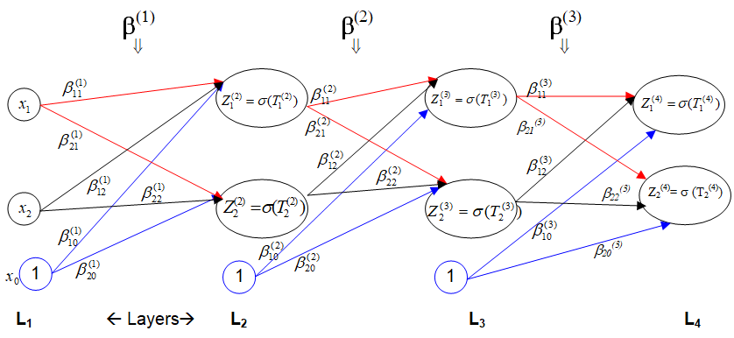
Tracing: Initialize Betas Randomly
Loop (i=1 to L-1): B{i} =[1.4.*rand(L(i)+1,L(i+1))-0.7];
B=
[1,1] =
-0.347446 0.688175
0.673095 0.650170
0.289817 -0.079249
[2,1] =
-0.21845 0.59235
0.15622 -0.30422
0.25791 0.46981
[3,1] =
-0.068978 -0.172063
-0.650880 0.173561
-0.419864 -0.321464

Slide 73
Tracing: T, Z, d cells creation
T=
Z=
[2,1] =
0
0
0
d=
[1,1] =
1
1
[2,1] =
0
0
[3,1] =
0
0
[1,1] =
0
0
[2,1] =
1
1
[3,1] =
1
1
[4,1] =
1
1
[1,1] =
0
0
0
[3,1] =
0
0
0
[4,1] =
0
0
[4,1] =
0
0

Slide 74
Tracing…
Flow of the code
Z{1} = [X(j,:) 1]’;
=
1.0000
1.1000
1.0000
Yk = Y(j,:)’;
= 1
0
CSqErr=0;
For Loop:
j=1 …

Slide 75
Tracing: Forward Prop
Flow of the FP code
T{i+1} = B{i}' * Z{i};
i=1
Z{1}=
1.0000
1.1000
1.0000
T{2}=
0.68278
1.32411
=
B{1}’=
-0.347446 0.673095 0.289817
0.688175 0.650170 -0.079249
*

Slide 76
Tracing: Forward Prop (FP)
Flow of the FP code
Z{i+1} = [(1./(1+exp(-T{i+1}))) ;1];
i=1
Z{2}
0.66436
0.78987
1.00000
T{2}=
f_{sig} (0.68278)
f_{sig} (1.32411)
=
And add: Z₀{2} =1

Slide 77
Tracing: Forward Prop …showing T, Z
Flow of the FP code
[1,1] =
1
1
[2,1] =
0.68278
1.32411
[3,1] =
0.23617
0.62305
[4,1] =
-0.88207
-0.30463
T =
[1,1] =
1.0000
1.1000
1.0000
[2,1] =
0.66436
0.78987
1.00000
[3,1] =
0.55877
0.65091
1.00000
[4,1] =
0.29275
0.42442
Z =

Slide 78


Tracing: Back Prop (BP)
δ^{(L=end=4)}
Flow of the BP code
Yk-Z{end} = 0.70725
-0.42442
d{end} = (Z{end}-Yk).*Z{end}.*(1-Z{end})
= $\left(\begin{aligned}−0.70725 \\ 0.42442\end{aligned}\right)$ .* $\left(\begin{aligned}0.29275 \\ 0.42442\end{aligned}\right)$ .* $\left(\begin{aligned}0.70725 \\ 0.57558\end{aligned}\right)$
(Yk-Z{end}).^2 = 0.50020
0.18014
= $\left(\begin{aligned}−0.14643 \\ 0.10368\end{aligned}\right)$
CSqErr= CSqErr+sum((Yk-Z{end}).^2)
CSqErr = CSqErr/L(end) %Normalizing
CSqErr = 0.34017

Slide 79

Tracing: Back Prop (BP)
δ⁽²⁾
δ⁽³⁾
δ⁽⁴⁾
Flow of the BP code
d{i}=Z{i}(1:end-1) .* (1-Z{i}(1:end-1)) .* sum ((d{i+1}’ .* B{i}(1:end-1,:)), 2)
i = 3
B{i}(1:end-1, :)
= -0.068978 -0.172063
-0.650880 0.173561
= 0.55877
0.65091
.*
0.44123 0.34909
.*
d{i+1}’
= -0.14643 0.10368
.*
= 0.24655
0.22723
.*
sum( $\left(\begin{aligned}0.010101 −0.017840 \\ 0.095311 0.017995\end{aligned}\right)$ , 2) = $\left(\begin{aligned}−0.0077391 \\ 0.1133063\end{aligned}\right)$
d{3} = -0.0019081
0.0257461
Notes:
sum (A, 2) => row wise sum of A.

Slide 80

Tracing: Back Prop (BP)
δ⁽²⁾
δ⁽³⁾
δ⁽⁴⁾
Flow of the BP code
d{i}=Z{i}(1:end-1) .* (1-Z{i}(1:end-1)) .* sum ((d{i+1}’ .* B{i}(1:end-1,:)), 2)
i = 2
.*
B{i}(1:end-1, :)
= -0.21845 0.59235
0.15622 -0.30422
= 0.66436
0.78987
.*
0.33564 0.21013
.*
d{i+1}’
= -0.0019081 0.0257461
= 0.22299
0.16598
.*
sum( $\left(\begin{aligned}0.00041681 0.01525067 \\ −0.00029807 −0.00783251\end{aligned}\right)$ , 2) = $\left(\begin{aligned}0.0156675 \\ −0.0081306\end{aligned}\right)$
d{2} = 0.0034936
-0.0013495
Notes:
sum (A, 2) => row wise sum of A.

Slide 81
Tracing: Back Prop (BP)
δ⁽²⁾
δ⁽³⁾
δ⁽⁴⁾
Update Beta(1) now
i = 1
B{i}(1:end-1,:)
= B{i}(1:end-1,:)
- alpha.*
(Z{i}(1:end-1) * d{i+1}')
- 0.2.*
1.0000
1.1000
*
0.0034936 -0.0013495
= -0.34745 0.68817
0.67310 0.65017
-
0.00069873 -0.00026990
0.00076860 -0.00029689
= -0.34815 0.68844
0.67233 0.65047

Slide 82
Tracing: Back Prop (BP)
δ⁽²⁾
δ⁽³⁾
δ⁽⁴⁾
Update Beta(1) [Bias ] now
i = 1
B{i}(end,:)
= B{i}(end,:)
- alpha.*
d{i+1}’
- 0.2.*
0.0034936 -0.0013495
= 0.289817 -0.079249
-
0.00069873 -0.00026990
= 0.289118 -0.078979

Slide 83
Tracing: Back Prop (BP)
δ⁽²⁾
δ⁽³⁾
δ⁽⁴⁾
Update Beta(2) now
i = 2
B{i}(1:end-1,:)
= B{i}(1:end-1,:)
- alpha.*
(Z{i}(1:end-1) * d{i+1}')
- 0.2.*
0.66436
0.78987
*
-0.0019081 0.0257461
= -0.21845 0.59235
0.15622 -0.30422
-
-0.00025353 0.00342093
-0.00030142 0.00406719
= -0.21820 0.58893
0.15652 -0.30829

Slide 84
Tracing: Back Prop (BP)
δ⁽²⁾
δ⁽³⁾
δ⁽⁴⁾
Update Beta(2) [Bias ] now
i = 2
B{i}(end,:)
= B{i}(end,:)
- alpha.*
d{i+1}’
- 0.2.*
-0.0019081 0.0257461
= 0.25791 0.46981
-
-0.00038161 0.00514922
= 0.25829 0.46466

Slide 85
Tracing: Back Prop (BP)
δ⁽²⁾
δ⁽³⁾
δ⁽⁴⁾
Update Beta(3) now
i = 3
B{i}(1:end-1,:)
= B{i}(1:end-1,:)
- alpha.*
(Z{i}(1:end-1) * d{i+1}')
- 0.2.*
0.55877 0.65091
*
-0.14643 0.10368
= -0.068978 -0.172063
-0.650880 0.173561
-
-0.016365 0.011587
-0.019063 0.013498
= -0.052613 -0.183650
-0.631817 0.160063

Slide 86
Tracing: Back Prop (BP)
δ⁽²⁾
δ⁽³⁾
δ⁽⁴⁾
Update Beta(3) [Bias ] now
i = 3
B{i}(end,:)
= B{i}(end,:)
- alpha.*
d{i+1}’
- 0.2.*
-0.14643 0.10368
= -0.41986 -0.32146
-
-0.029287 0.020736
= ‭-0.39058 -0.34220

Slide 87
Min_Error = 0.00054252
Min_Error_Epoch = 193
Max_Error = 10000
L = [2 2 2 2] % Two Node Output
Epoch vs. Training Error

Slide 88
L = [2 2 2 2]
Epoch vs. Training Error

Slide 89
L = [2 2 2 2]
Epoch vs. Training Error

Slide 90
Test Cases
L = [2 2 2 2]
Test point 1 [0.5, 0.3]
Z_{k}
Y_{k}
Benign: 1
0
Ans (1) = 0.9989
0.0011
Test point 2 [5.0, 4.0]
Ans (2) = 0.0306
0.9694
Malignant: 0
1

Slide 91
Min_Error = 0.00042376
Min_Error_Epoch = 85
Max_Error = 10000
L = [2 4 4 2] % Two Node Output
Epoch vs. Training Error

Slide 92
L = [2 4 4 2]
Epoch vs. Training Error

Slide 93
L = [2 4 4 2]
Epoch vs. Training Error

Slide 94
Test Cases
L = [2 4 4 2]
Test point 1 [0.5, 0.3]
Z_{k}
Y_{k}
Benign: 1
0
Ans (1) = 0.9867
0.0129
Test point 2 [5.0, 4.0]
Ans (2) = 0.0431
0.9570
Malignant: 0
1

Slide 95
Tracing: ANN for Batch Learning with One Output Node
Size (X₁) | Age (X₂)
1 | 1.1
0.9 | 1.9
0.65 | 3.75
2.45 | 3.67
… | …
B=0, M=1
0
0
1
1
…
X=
Y=
Network, L = [2 2 2 1]

Slide 96
Tracing: Initialize Betas Randomly
Loop (i=1 to L-1): B{i} =[1.4.*rand(L(i)+1,L(i+1))-0.7];
B=
[3,1] =
-0.43204
-0.17247
0.43096
[1,1] =
-0.058111 -0.404926
0.085533 0.347979
-0.262331 -0.567523
[2,1] =
-0.352890 -0.099131
0.136254 -0.411356
-0.690521 -0.597851
Next T, Z, d cells are initialized (not shown).

Slide 97
Tracing…
Flow of the code
Z{1} = [X ones(Nx, 1)]’;
=
1.00000 0.90000 0.65000 2.45000
1.10000 1.90000 3.75000 3.67000
1.00000 1.00000 1.00000 1.00000
Y’ = 0 0 1 1
Loop
CSqErr=0;

Slide 98
Tracing: Forward Prop
Flow of the FP code
T{i+1} = B{i}' * Z{i};
i=1
=
Z{1}=
1.00000 0.90000 0.65000 2.45000
1.10000 1.90000 3.75000 3.67000
1.00000 1.00000 1.00000 1.00000
T{2}=
-0.226356 -0.152119 0.020644 -0.090798
-0.589672 -0.270797 0.474196 -0.282510
*
B{1}’=
-0.058111 0.085533 -0.262331
-0.404926 0.347979 -0.567523

Slide 99
Tracing: Forward Prop (FP)
f_{sig}
Flow of the FP code
Z{i+1}=[(1./(1+exp(-T{i+1}))); ones(Nx,1)']
i=1
Z{2}=
0.44365 0.46204 0.50516 0.47732
0.35671 0.43271 0.61638 0.42984
1.00000 1.00000 1.00000 1.00000
=
And
add:
Z₀{2} =
1 1 1 1
T{2}=
f_{sig}(-0.226356) f_{sig}(-0.152119) f_{sig}(0.020644) f_{sig}(-0.090798)
f_{sig}(-0.5896720) f_{sig}( -0.270797) f_{sig}(0.474196) f_{sig}(-0.282510)

Slide 100
Tracing: Forward Prop …showing T, Z
Flow of the FP code
[1,1]
= 1
1
[2,1] =
-0.226356 -0.152119 0.020644 -0.090798
-0.589672 -0.270797 0.474196 -0.282510
[3,1] =
-0.79848 -0.79461 -0.78480 -0.80039
-0.78857 -0.82165 -0.90148 -0.82198
[4,1] =
0.24298 0.24384 0.24580 0.24439
T =
[1,1] =
1.00000 0.90000 0.65000 2.45000
1.10000 1.90000 3.75000 3.67000
1.00000 1.00000 1.00000 1.00000
[2,1] =
0.44365 0.46204 0.50516 0.47732
0.35671 0.43271 0.61638 0.42984
1.00000 1.00000 1.00000 1.00000
[3,1] =
0.31035 0.31118 0.31329 0.30994
0.31248 0.30541 0.28875 0.30534
1.00000 1.00000 1.00000 1.00000
Z =
[4,1] =
0.56045 0.56066 0.56114 0.56079

Slide 101
Tracing: Back Prop (BP)
δ^{(L=end=4)}
Flow of the BP code
Y’-Z{end}
= -0.56045 -0.56066 0.43886 0.43921
d{end} = (Z{end}-Y’) .* Z{end} .* (1-Z{end})
= (0.56045 0.56066 -0.43886 -0.43921)
.* (0.56045 0.56066 0.56114 0.56079)
.* (0.43955 0.43934 0.43886 0.43921)
(Yk-Z{end}).^2
= 0.31410 0.31434 0.19260 0.19290
CSqErr= CSqErr+sum((Yk-Z{end}).^2)
CSqErr = CSqErr/L(end) %Normalizing
CSqErr = 1.0139
= 0.13806 0.13810 -0.10807 -0.10818

Slide 102
Tracing: Back Prop (BP)
BP Code: Online Version
BP Code: Batch Version
d{end}=(Z{end}-Yk).*Z{end}.*(1-Z{end});
d{end}=(Z{end}-Y).*Z{end}.*(1-Z{end});
for i=length(L)-1:-1:2
W=Z{i}(1:end-1,:).*(1-Z{i}(1:end-1,:)); D= d{i+1}';
for m = 1:Nx
d{i}(:,m)=W(:,m).*sum((D(m,:).*B{i}(1:end-1,:)),2);
end
end
for i=length(L)-1:-1:2
d{i} = Z{i}(1:end-1).*(1-Z{i}(1:end-1)) * sum((d{i+1}'.*B{i}(1:end-1,:)),2);
end
Update Betas
Update Betas
for i=1:length(L)-1
W = Z{i}(1:end-1,:); D = d{i+1}’;
V1 = zeros(L(i),L(i+1)); V2 = zeros(1,L(i+1));
for m = 1:Nx
V1 = V1 + (W(:,m)*D(m,:));
V2 = V2 + D(m,:);
end
B{i}(1:end-1,:)=B{i}(1:end-1,:)-(alpha/Nx).*V1;
B{i}(end,:) = B{i}(end,:)-(alpha/Nx).*V2;
end
for i=1:length(L)-1
B{i}(1:end-1,:)=B{i}(1:end-1,:)-alpha.*(Z{i}(1:end-1)*d{i+1}');
B{i}(end,:)=B{i}(end,:)-alpha.*d{i+1}';
end

Slide 103
Tracing: Back Prop (BP)
δ⁽³⁾
δ⁽⁴⁾
D= d{i+1}';
Flow of the BP code
W=Z{i}(1:end-1,:).*(1-Z{i}(1:end-1,:));
i = 3
W=
0.13806
0.13810
-0.10807
-0.10818
0.21403 0.21435 0.21514 0.21388
0.21484 0.21214 0.20537 0.21211
B{i}(1:end-1,:)=
-0.43204
-0.17247
for m = 1:Nx
d{i}(:,m)=W(:,m).*sum((D(m,:).*B{i}(1:end-1,:)),2);
end
d{3}= -0.0127668 -0.0127890 0.0100451 0.0099960
-0.0051157 -0.0050528 0.0038280 0.0039574
Notes:
mean (A, 2) => row wise mean of matrix A

Slide 104
Tracing: Back Prop (BP)
δ⁽²⁾
δ⁽³⁾
δ⁽⁴⁾
D= d{i+1}';
Flow of the BP code
W=Z{i}(1:end-1,:).*(1-Z{i}(1:end-1,:));
i = 2
W=
-0.0127668 -0.0051157
-0.0127890 -0.0050528
0.0100451 0.0038280
0.0099960 0.0039574
0.24682 0.24856 0.24997 0.24949
0.22947 0.24547 0.23646 0.24508
B{i}(1:end-1,:)=
-0.352890 -0.099131
0.136254 -0.411356
for m = 1:Nx
d{i}(:,m)=W(:,m).*sum((D(m,:).*B{i}(1:end-1,:)),2);
end
d{2}= 0.001237183 0.001246274 -0.000980970 -0.000977927
0.000083716 0.000082462 -0.000048709 -0.000065171
Notes:
mean (A, 2) => row wise mean of matrix A

Slide 105
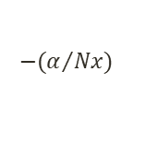
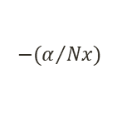
Tracing: Back Prop (BP)
δ⁽²⁾
δ⁽³⁾
δ⁽⁴⁾
Update Beta(1) now
W = Z{i}(1:end-1,:);
V1 = zeros(L(i),L(i+1));
V2 = zeros(1,L(i+1))
D = d{i+1}';
i = 1
W =
1.00000 0.90000 0.65000 2.45000
1.10000 1.90000 3.75000 3.67000
V2 =
0 0
0.001237183 0.000083716
0.001246274 0.000082462
-0.000980970 -0.000048709
-0.000977927 -0.000065171
V1 =
0 0
0 0
for m = 1:Nx V1 = V1 + (W(:,m)*D(m,:)); V2 = V2 + D(m,:); end
B{i}(1:end-1,:) = B{i}(1:end-1,:) - (alpha/Nx) .* V1;
-0.058077 -0.404924 =
0.085710 0.347987
-0.058111 -0.404926
0.085533 0.347979
$$−(α/{Nx})$$
.*
-0.000674723 -0.000033397
-0.003538810 -0.000173069
B{i}(end,:) = B{i}(end,:) - (alpha/Nx) .* V2;
-0.26236 -0.56753 =
-0.26233 -0.56752
$$−(α/{Nx})$$
.*
0.000524559 0.000052299

Slide 106
Tracing: Back Prop (BP)
δ⁽²⁾
δ⁽³⁾
δ⁽⁴⁾
Update Beta(1) now
W = Z{i}(1:end-1,:);
V1 = zeros(L(i),L(i+1));
V2 = zeros(1,L(i+1))
D = d{i+1}';
i = 2
W =
0.44365 0.46204 0.50516 0.47732
0.35671 0.43271 0.61638 0.42984
V2 =
0 0
-0.0127668 -0.0051157
-0.0127890 -0.0050528
0.0100451 0.0038280
0.0099960 0.0039574
V1 =
0 0
0 0
for m = 1:Nx V1 = V1 + (W(:,m)*D(m,:)); V2 = V2 + D(m,:); end
B{i}(1:end-1,:) = B{i}(1:end-1,:) - (alpha/Nx) .* V1;
-0.352804 -0.099091 =
0.136234 -0.411358
-0.352890 -0.099131
0.136254 -0.411356
$$−(α/{Nx})$$
.*
-0.001727439 -0.000781449
0.000400239 0.000049367
B{i}(end,:) = B{i}(end,:) - (alpha/Nx) .* V2;
-0.69025 -0.59773 =
-0.69052 -0.59785
$$−(α/{Nx})$$
.*
-0.0055147 -0.0023830

Slide 107
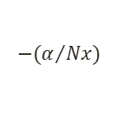
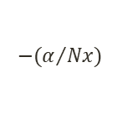
Tracing: Back Prop (BP)
δ⁽²⁾
δ⁽³⁾
δ⁽⁴⁾
Update Beta(1) now
W = Z{i}(1:end-1,:);
V1 = zeros(L(i),L(i+1));
V2 = zeros(1,L(i+1))
D = d{i+1}';
i = 3
W =
0.31035 0.31118 0.31329 0.30994
0.31248 0.30541 0.28875 0.30534
V2 =
0 0
0.13806
0.13810
-0.10807
-0.10818
V1 =
0 0
0 0
for m = 1:Nx V1 = V1 + (W(:,m)*D(m,:)); V2 = V2 + D(m,:); end
B{i}(1:end-1,:) = B{i}(1:end-1,:) - (alpha/Nx) .* V1;
-0.43296=
-0.17352
-0.43204
-0.17247
$$−(α/{Nx})$$
.*
0.018436
0.021083
B{i}(end,:) = B{i}(end,:) - (alpha/Nx) .* V2;
0.42796 =
0.43096
$$−(α/{Nx})$$
.*
0.059914

Slide 108
L=[2 2 2 1] % Batch / One Node Output
Min_Error = 0.0604
Min_Error_Epoch = 10000
Max_Epoch = 10000
Epoch vs. Training Error

Slide 109
L = [2 2 2 1]
Epoch vs. Training Error

Slide 110
L = [2 2 2 1]
Epoch vs. Training Error

Slide 111
Test Cases
L = [2 2 2 1] /Batch
Test point 1 [0.5, 0.3]
Z_{k}
Y
Benign: 0
Ans (1) = 0.0119
Test point 2 [5.0, 4.0]
Ans (2) = 0.9583
Malignant: 1

Slide 112
Min_Error = 0.0597
Min_Error_Epoch = 10000
Max_Epoch = 10000
L=[2 4 4 1] % Batch / One Node Output
Epoch vs. Training Error

Slide 113
L = [2 4 4 1]
Epoch vs. Training Error

Slide 114
L = [2 4 4 1]
Epoch vs. Training Error

Slide 115
Test Cases
L = [2 4 4 1] /Batch
Test point 1 [0.5, 0.3]
Z_{k}
Y
Benign: 0
Ans (1) = 0.0034
Test point 2 [5.0, 4.0]
Ans (2) = 0.9935
Malignant: 1

Slide 116
Tracing: ANN for Batch Learning with Two Output Node
Size (X₁) | Age (X₂)
1 | 1.1
0.9 | 1.9
0.65 | 3.75
2.45 | 3.67
… | …
B, M
1 0
1 0
0 1
0 1
…
X=
Y=
Network, L = [2 2 2 2]

Slide 117
Tracing: Initialize Betas Randomly
Loop (i=1 to L-1): B{i} =[1.4.*rand(L(i)+1,L(i+1))-0.7];
B=
[3,1] =
-0.5051583 0.4843785
0.6852166 0.1692277
-0.0076186 -0.6312365
[1,1] =
0.216937 0.652051
0.411549 -0.045039
0.613799 0.413166
[2,1] =
0.660601 -0.103519
0.171086 0.097580
0.246479 0.244508
Next T, Z, d cells are initialized (not shown).

Slide 118
Tracing…
Flow of the code
Z{1} = [X ones(Nx, 1)]’;
=
1.00000 0.90000 0.65000 2.45000
1.10000 1.90000 3.75000 3.67000
1.00000 1.00000 1.00000 1.00000
Y = 1 1 0 0
0 0 1 1
Loop
CSqErr=0;

Slide 119
Tracing: Forward Prop
Flow of the FP code
T{i+1} = B{i}' * Z{i};
i=1
=
Z{1}=
1.00000 0.90000 0.65000 2.45000
1.10000 1.90000 3.75000 3.67000
1.00000 1.00000 1.00000 1.00000
T{2}=
1.28344 1.59099 2.29812 2.65568
1.01567 0.91444 0.66810 1.84540
*
B{1}’=
0.216937 0.411549 0.613799
0.652051 -0.045039 0.413166

Slide 120
Tracing: Forward Prop (FP)
f_{sig}
Flow of the FP code
Z{i+1}=[(1./(1+exp(-T{i+1}))); ones(Nx,1)']
i=1
Z{2}=
0.78303 0.83075 0.90872 0.93436
0.73413 0.71391 0.66108 0.86359
1.00000 1.00000 1.00000 1.00000
=
And
add:
Z₀{2} =
1 1 1 1
T{2}=
f_{sig}(1.28344) f_{sig}(1.59099) f_{sig}(2.29812) f_{sig}(2.65568)
f_{sig}(1.01567) f_{sig}(0.91444) f_{sig}(0.66810) f_{sig}(1.84540)

Slide 121
Tracing: Forward Prop …showing T, Z
Flow of the FP code
[1,1]
= 1
1
[2,1] =
1.28344 1.59099 2.29812 2.65568
1.01567 0.91444 0.66810 1.84540
[3,1] =
0.88935 0.91742 0.95988 1.01147
0.23509 0.22817 0.21495 0.23205
[4,1] =
0.0170422 0.0129645 0.0063907 0.0041278
-0.1934160 -0.1909151 -0.1873105 -0.1816509
T =
[1,1] =
1.00000 0.90000 0.65000 2.45000
1.10000 1.90000 3.75000 3.67000
1.00000 1.00000 1.00000 1.00000
[2,1] =
0.78303 0.83075 0.90872 0.93436
0.73413 0.71391 0.66108 0.86359
1.00000 1.00000 1.00000 1.00000
[3,1] =
0.70876 0.71452 0.72310 0.73331
0.55850 0.55680 0.55353 0.55775
1.00000 1.00000 1.00000 1.00000
Z =
[4,1] =
0.50426 0.50324 0.50160 0.50103
0.45180 0.45242 0.45331 0.45471

Slide 122
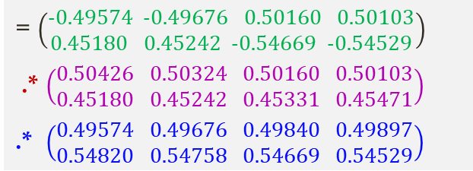
Tracing: Back Prop (BP)
δ^{(L=end=4)}
Flow of the BP code
Y-Z{end}
= 0.49574 0.49676 -0.50160 -0.50103
-0.45180 -0.45242 0.54669 0.54529
d{end} = (Z{end}-Y’) .* Z{end} .* (1-Z{end})
= $\left(\begin{aligned}−0.49574 −0.49676 0.50160 0.50103 \\ 0.45180 0.45242 −0.54669 −0.54529\end{aligned}\right)$
.* $\left(\begin{aligned}0.50426 0.50324 0.50160 0.50103 \\ 0.45180 0.45242 0.45331 0.45471\end{aligned}\right)$
.* $\left(\begin{aligned}0.49574 0.49676 0.49840 0.49897 \\ 0.54820 0.54758 0.54669 0.54529\end{aligned}\right)$
(Yk-Z{end}).^2
= 0.24576 0.24677 0.25160 0.25103
0.20412 0.20468 0.29887 0.29734
CSqErr= CSqErr+sum(sum(((Y-Z{end}).^2),1))
CSqErr = CSqErr/L(end) %Normalizing
CSqErr = 1.0001
= -0.12393 -0.12418 0.12540 0.12526
0.11190 0.11208 -0.13548 -0.13520

Slide 123
Tracing: Back Prop (BP)
δ⁽³⁾
δ⁽⁴⁾
D= d{i+1}';
Flow of the BP code
W=Z{i}(1:end-1,:).*(1-Z{i}(1:end-1,:));
i = 3
W=
-0.12393 0.11190
-0.12418 0.11208
0.12540 -0.13548
0.12526 -0.13520
0.20642 0.20398 0.20023 0.19557
0.24658 0.24677 0.24713 0.24666
B{i}(1:end-1,:)=
-0.50516 0.48438
0.68522 0.16923
for m = 1:Nx
d{i}(:,m)=W(:,m).*sum((D(m,:).*B{i}(1:end-1,:)),2);
end
d{3}= 0.024111 0.023870 -0.025823 -0.025182
-0.016269 -0.016318 0.015569 0.015527
Notes:
mean (A, 2) => row wise mean of matrix A

Slide 124
Tracing: Back Prop (BP)
δ⁽²⁾
δ⁽³⁾
δ⁽⁴⁾
D= d{i+1}';
Flow of the BP code
W=Z{i}(1:end-1,:).*(1-Z{i}(1:end-1,:));
i = 2
W=
0.024111 -0.016269
0.023870 -0.016318
-0.025823 0.015569
-0.025182 0.015527
0.169891 0.140601 0.082947 0.061331
0.195184 0.204244 0.224054 0.117805
B{i}(1:end-1,:)=
-0.352890 -0.099131
0.136254 -0.411356
for m = 1:Nx
d{i}(:,m)=W(:,m).*sum((D(m,:).*B{i}(1:end-1,:)),2);
end
d{2}= 0.00299208 0.00245463 -0.00154867 -0.00111885
0.00049527 0.00050889 -0.00064948 -0.00032905
Notes:
mean (A, 2) => row wise mean of matrix A

Slide 125
Tracing: Back Prop (BP)
δ⁽²⁾
δ⁽³⁾
δ⁽⁴⁾
Update Beta(1) now
W = Z{i}(1:end-1,:);
V1 = zeros(L(i),L(i+1));
V2 = zeros(1,L(i+1))
D = d{i+1}';
i = 1
W =
1.00000 0.90000 0.65000 2.45000
1.10000 1.90000 3.75000 3.67000
V2 =
0 0
0.00299208 0.00049527
0.00245463 0.00050889
-0.00154867 -0.00064948
-0.00111885 -0.00032905
V1 =
0 0
0 0
for m = 1:Nx V1 = V1 + (W(:,m)*D(m,:)); V2 = V2 + D(m,:); end
B{i}(1:end-1,:) = B{i}(1:end-1,:) - (alpha/Nx) .* V1;
0.216865 0.652065 =
0.411647 -0.044932
0.216937 0.652051
0.411549 -0.045039
$$−(α/{Nx})$$
.*
0.00145343 -0.00027507
-0.00195860 -0.00213151
B{i}(end,:) = B{i}(end,:) - (alpha/Nx) .* V2;
0.61366 0.41316 =
0.61380 0.41317
$$−(α/{Nx})$$
.*
0.002779192 0.000025621

Slide 126
Tracing: Back Prop (BP)
δ⁽²⁾
δ⁽³⁾
δ⁽⁴⁾
Update Beta(1) now
W = Z{i}(1:end-1,:);
V1 = zeros(L(i),L(i+1));
V2 = zeros(1,L(i+1))
D = d{i+1}';
i = 2
W =
0.78303 0.83075 0.90872 0.93436
0.73413 0.71391 0.66108 0.86359
V2 =
0 0
0.024111 -0.016269
0.023870 -0.016318
-0.025823 0.015569
-0.025182 0.015527
V1 =
0 0
0 0
for m = 1:Nx V1 = V1 + (W(:,m)*D(m,:)); V2 = V2 + D(m,:); end
B{i}(1:end-1,:) = B{i}(1:end-1,:) - (alpha/Nx) .* V1;
0.661015 -0.103637 =
0.171290 0.097575
0.660601 -0.103519
0.171086 0.097580
$$−(α/{Nx})$$
.*
-0.00828539 0.00235997
-0.00407653 0.00010791
B{i}(end,:) = B{i}(end,:) - (alpha/Nx) .* V2;
0.24663 0.24458 =
0.24648 0.24451
$$−(α/{Nx})$$
.*
-0.0030243 -0.0014913

Slide 127
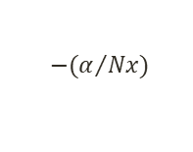
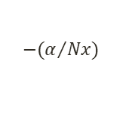
Tracing: Back Prop (BP)
δ⁽²⁾
δ⁽³⁾
δ⁽⁴⁾
Update Beta(1) now
W = Z{i}(1:end-1,:);
V1 = zeros(L(i),L(i+1));
V2 = zeros(1,L(i+1))
D = d{i+1}';
i = 3
W =
0.70876 0.71452 0.72310 0.73331
0.55850 0.55680 0.55353 0.55775
V2 =
0 0
-0.12393 0.11190
-0.12418 0.11208
0.12540 -0.13548
0.12526 -0.13520
V1 =
0 0
0 0
for m = 1:Nx V1 = V1 + (W(:,m)*D(m,:)); V2 = V2 + D(m,:); end
B{i}(1:end-1,:) = B{i}(1:end-1,:) - (alpha/Nx) .* V1;
.*
-0.50546 0.48626 =
0.68517 0.17050
-0.50516 0.48438
0.68522 0.16923
$$−(α/{Nx})$$
0.00596232 -0.03771999
0.00091616 -0.02550179
B{i}(end,:) = B{i}(end,:) - (alpha/Nx) .* V2;
-0.0077459 -0.6289012 =
-0.0076186 -0.6312365
$$−(α/{Nx})$$
.*
0.0025452 -0.0467059

Slide 128
Min_Error = 0.0592
Min_Error_Epoch = 10000
Max_Epoch = 10000
L=[2 2 2 2] % Batch / Two Node Output
Epoch vs. Training Error

Slide 129
L = [2 2 2 2]
Epoch vs. Training Error

Slide 130
L = [2 2 2 2]
Epoch vs. Training Error

Slide 131
Test Cases
L = [2 2 2 2] /Batch
Test point 1 [0.5, 0.3]
Z_{k}
Y
Benign: 1
0
Ans (1) = 0.9700
0.0313
Test point 2 [5.0, 4.0]
Ans (2) = 0.0503
0.9478
Malignant: 0
1

Slide 132
Min_Error = 0.0588
Min_Error_Epoch = 10000
Max_Epoch = 10000
L=[2 4 4 2] % Batch / Two Node Output
Epoch vs. Training Error

Slide 133
L = [2 4 4 2]
Epoch vs. Training Error

Slide 134
L = [2 4 4 2]
Epoch vs. Training Error

Slide 135
Test Cases
L = [2 4 4 2] /Batch
Test point 1 [0.5, 0.3]
Z_{k}
Y
Benign: 1
0
Ans (1) = 0.9896
0.0095
Test point 2 [5.0, 4.0]
Ans (2) = 0.0170
0.9841
Malignant: 0
1

Slide 136
Some Issues in Training NN (important)
The model is generally overparametrized, and the optimization problem can be nonconvex and unstable unless certain guidelines are followed.
Starting values:
if the weights are near zero, then the operative part of the sigmoid is roughly linear, and hence the neural network collapses into an approximately linear model. Use of exact zero weights leads to zero derivatives and perfect symmetry, and the algorithm never moves. Starting instead with large weights often leads to poor solutions.
Usually starting values for weights are chosen to be random values near zero. Hence the model starts out nearly linear, and becomes nonlinear as the weights increase.

Slide 137
Some Issues in Training NN …
Overfitting: Often neural networks have too many weights and can overfit the data.
Early stopping rule was used to avoid overfitting before.
A validation dataset is useful for determining when to stop, since we expect the validation error to start increasing.
A more explicit method for regularization is weight decay, which is analogous to ridge regression used for linear models. We add a penalty to the error function:
and λ ≥ 0 is a tuning parameter. Larger values of λ will tend to shrink the weights toward zero: typically cross-validation is used to estimate λ.
Other forms for the penalty have been proposed, known as the weight elimination penalty:

Slide 138
Overfitting … (Some Issues in Training NN)
Panel (a) uses no weight decay, and overfits the training data.
Panel (b) uses weight decay, and achieves close to the Bayes error rate (broken purple boundary).

Slide 139
Scaling … (Some Issues in Training NN)
Since the scaling of the inputs determines the effective scaling of the weights in the bottom layer, it can have a large effect on the quality of the final solution.
At the outset it is best to standardize all inputs to have mean zero and standard deviation one.
This ensures all inputs are treated equally in the regularization process and allows one to choose a meaningful range for the random starting weights.
With standardized inputs, it is typical to take random uniform weights over the range [−0.7, +0.7].

Slide 140
Number of Hidden Units and Layers … (Some Issues in Training NN)
Generally speaking it is better to have too many hidden units than too few.
With too few hidden units, the model might not have enough flexibility to capture the nonlinearities in the data;
with too many hidden units, the extra weights can be shrunk toward zero if appropriate regularization is used.
Typically the number of hidden units is somewhere in the range of 5 to 100, with the number increasing with the number of inputs and number of training cases.
It is most common to put down a reasonably large number of units and train them with regularization.

Slide 141
Formulas for Measuring Classification Performance
The confusion matrix: Here, we make
a square matrix that contains all the possible classes in both the horizontal and vertical directions and
list the classes along the top of a table as the predicted outputs, and then
down the left-hand side as the targets.
Example, the element of the matrix at (i, j) tells us how many input patterns were put into class i in the targets, but class j by the algorithm.
Anything on the leading diagonal (the diagonal that starts at the top left of the matrix and runs down to the bottom right) is a correct answer.
Suppose that we have three classes: C₁, C₂, and C₃. Now we count the number of times that the output was class C₁ when the target was C₁, then when the target was C₂, and so on until we’ve filled in the table:
Predicted Output

Slide 142
…Formulas for Measuring Classification Performance
Accuracy metrics:
Assume a new test method is applied to screen people for cancer. The test results can be positive (have cancer) or negative (do not have cancer).
The prediction or test results for each subject may or may not match the subject's actual status. In this context, the terminologies –
True Positive (TP) refers to the situation, where subjects having cancers are predicted to have cancer;
True Negative (TN) refers to the situation, where subjects do not have cancer are predicted to have no cancer;
False Positive (FP) refers to the situation, where subjects do not have cancer but are predicted to have cancer;
False Negative (FN) refers to the situation, where subjects have cancer but are predicted to have no cancer.

Slide 143
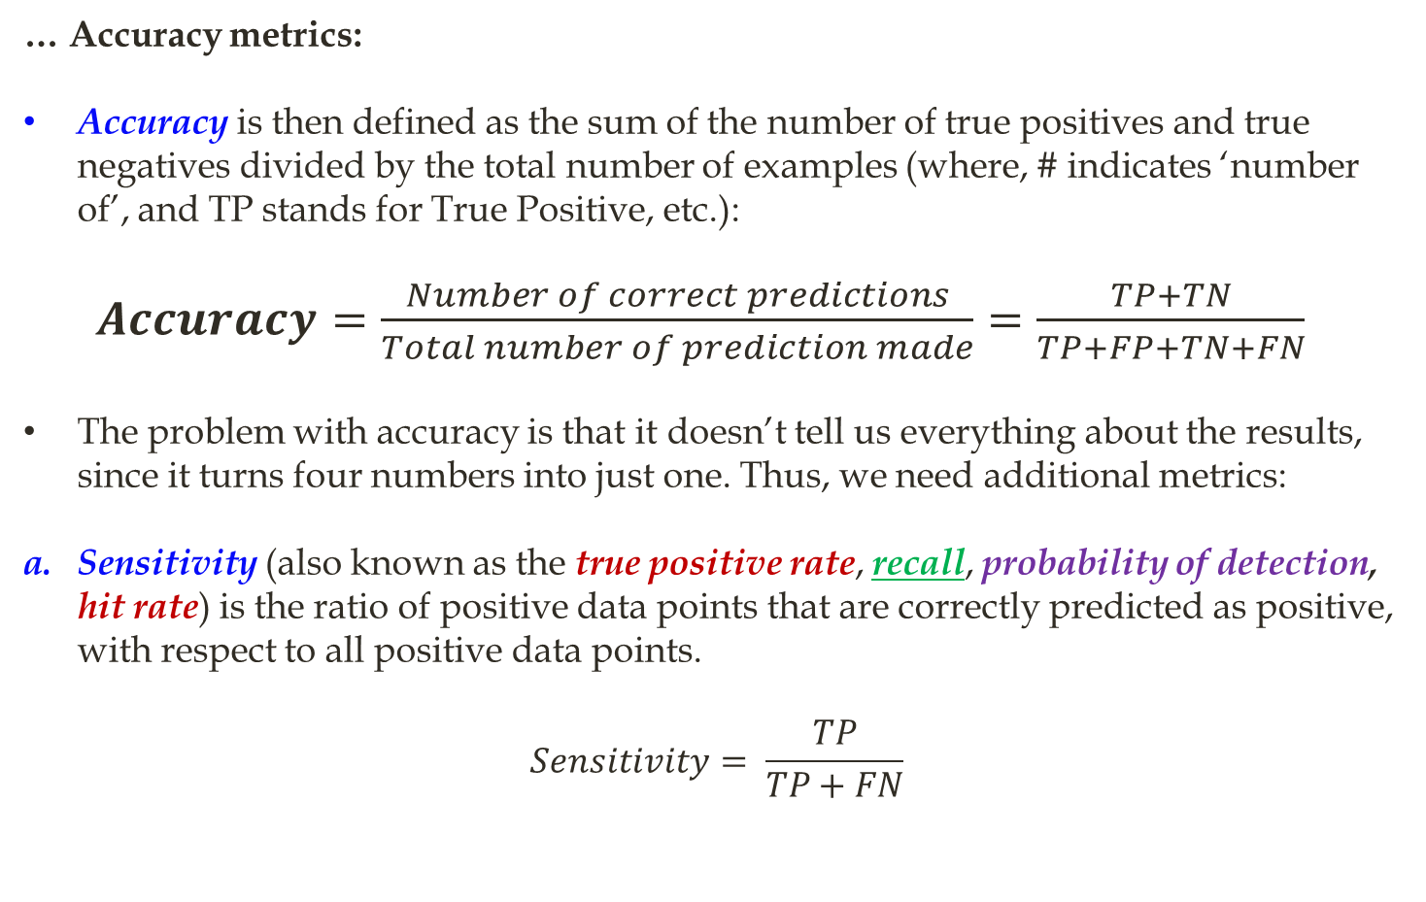
…Formulas for Measuring Classification Performance
… Accuracy metrics:
Accuracy is then defined as the sum of the number of true positives and true negatives divided by the total number of examples (where, # indicates ‘number of’, and TP stands for True Positive, etc.):
$Accuracy=\frac{Number of correct predictions}{Total number of prediction made}=\frac{TP+TN}{TP+FP+TN+FN}$
The problem with accuracy is that it doesn’t tell us everything about the results, since it turns four numbers into just one. Thus, we need additional metrics:
Sensitivity (also known as the true positive rate, recall, probability of detection, hit rate) is the ratio of positive data points that are correctly predicted as positive, with respect to all positive data points.
$$Sensitivity= \frac{TP}{TP+FN}$$

Slide 144
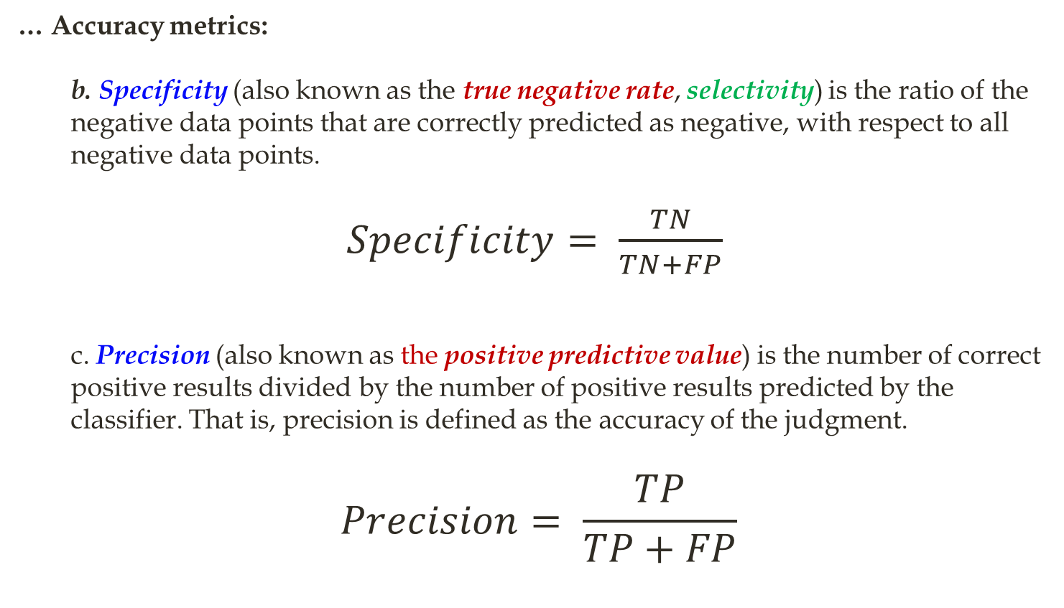
…Formulas for Measuring Classification Performance
… Accuracy metrics:
b. Specificity (also known as the true negative rate, selectivity) is the ratio of the negative data points that are correctly predicted as negative, with respect to all negative data points.
$Specificity= \frac{TN}{TN+FP}$
c. Precision (also known as the positive predictive value) is the number of correct positive results divided by the number of positive results predicted by the classifier. That is, precision is defined as the accuracy of the judgment.
$$Precision= \frac{TP}{TP+FP}$$

Slide 145
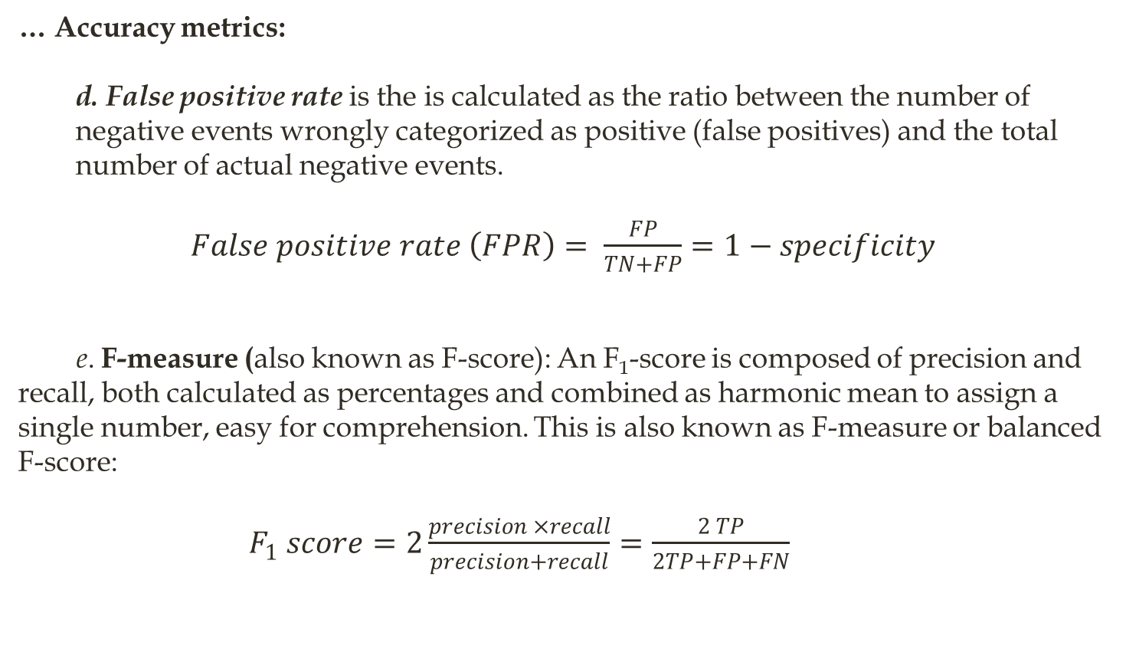
…Formulas for Measuring Classification Performance
… Accuracy metrics:
d. False positive rate is the is calculated as the ratio between the number of negative events wrongly categorized as positive (false positives) and the total number of actual negative events.
$False positive rate \left(FPR\right)= \frac{FP}{TN+FP}=1−specificity$
e. F-measure (also known as F-score): An F₁-score is composed of precision and recall, both calculated as percentages and combined as harmonic mean to assign a single number, easy for comprehension. This is also known as F-measure or balanced F-score:
$F_{1} score=2\frac{precision ×recall}{precision+recall}=\frac{2 TP}{2TP+FP+FN}$

Slide 146
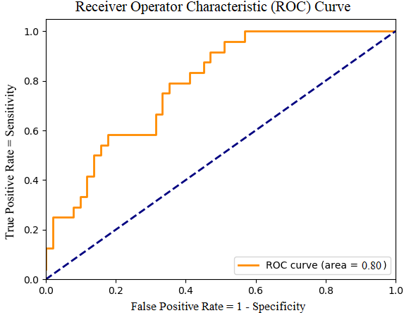
…Formulas for Measuring Classification Performance
The Receiver Operator Characteristic (ROC) curve: To draw ROC curve, TPR and FPR both are computed at threshold values such as (0.00, 0.02, 0.04, …., 1.00) and a graph is drawn (see Figure 1). The AUC is the area under the curve of the plot. AUC close to or equal to 1.0 indicates the best performance.
Figure 1: An example of an ROC curve. The diagonal line represents exactly a chance, so anything above the line is better than chance, and the further from the line, the better.

Slide 147
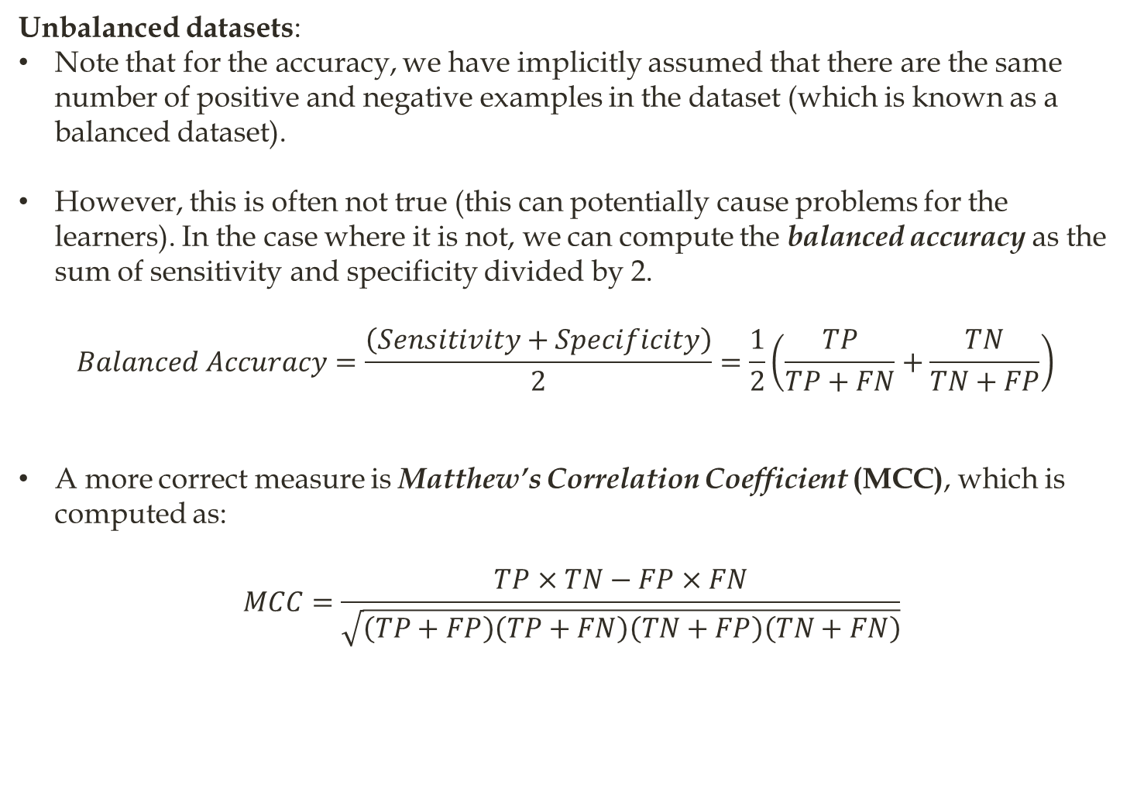
…Formulas for Measuring Classification Performance
Unbalanced datasets:
Note that for the accuracy, we have implicitly assumed that there are the same number of positive and negative examples in the dataset (which is known as a balanced dataset).
However, this is often not true (this can potentially cause problems for the learners). In the case where it is not, we can compute the balanced accuracy as the sum of sensitivity and specificity divided by 2.
$$Balanced Accuracy=\frac{\left(Sensitivity+Specificity\right)}{2}=\frac{1}{2}\left(\frac{TP}{TP+FN}+\frac{TN}{TN+FP}\right)$$
A more correct measure is Matthew’s Correlation Coefficient (MCC), which is computed as:
$$MCC=\frac{TP×TN−FP×FN}{\sqrt{\left(TP+FP\right)\left(TP+FN\right)\left(TN+FP\right)\left(TN+FN\right)}}$$
End

